Slide 1


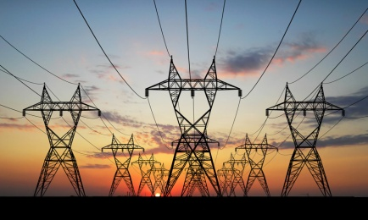







IPSP Space Weather
Socio-Economic Study
L5 in Tandem with L1 : Future Space Weather Missions Workshop
Monday 6th March 2017
Enrico Biffis / Catherine Burnett

Slide 2
Project Strategy
Literature Review defined economic strategy
Space Weather Events -
Everyday or 1 in 10 year (2003 event)
1 in 30 year (1989 event)
1 in 100 year (Carrington scale event)
Forecast Capability -
None = loss of existing key L1 satellite observations
Current capability with existing key L1 satellite observations
Enhanced capability L1 and L5 satellite observations
Collate user and proxy data
Notes:
The literature review demonstrated that the most appropriate methodology was to mirror the approach of the insurance industry, where loss occurrence is divided into a hazard component (event occurrence) and a loss severity component (damage conditional on the hazard event occurrence).
This means that if the loss-severity component can be quantified for individual scenarios that characterise the event occurrence distribution, then full knowledge of the aggregated cost of all likely space weather can be determined over a specified interval.
On this basis, it was decided to examine the economic impact of three different scenarios: a 1-in-10 year event (e.g. the 2003 storms), a 1-in-30 year event (e.g. the 1989 storms) and a 1-in-100 year event (e.g. the Carrington events of 1859)

Slide 3
Forecast Scenario
No forecast available - Existing satellite observing systems are lost orno t replaced
The current level of forecast – Based on data from multiple satellites
Deep Space Climate Observatory (DSCOVR)
Solar and Heliospheric Observatory(SOHO)
Advanced Composition Explorer (ACE)
Geostationary Operational Environmental Satellite (GOES)
Solar Dynamic Observatory (SDO)
Improved level of forecasting – Reflecting the standard that could be achieved if the current observation satellites were supplemented by satellites off the Sun Earth line, as demonstrated by the STEREO mission e.g. at the Lagrange 4 (L4)or Lagrange 5(L5) positions
Notes:
Space weather forecasting, and CME forecasting in particular, relies on observations from a small number of satellites, we considered how the quality of the forecast might be modified if these observations were enhanced or to become unavailable.
The value of space weather forecasting in these three capability levels was considered.

Slide 4
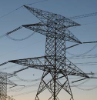

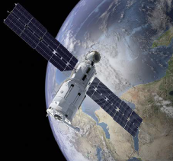
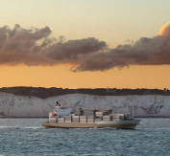
Areas of Study
Power Grids
Geomagnetic Storms
Aviation
Solar Flares and Geomagnetic Storms
Satellite Operations
Radiation and Geomagnetic Storms
GNSS Services
Geomagnetic Storms
Notes:
Our literature survey shows that the most important impact is on power for which geomagnetic storms are the most significant impact.
The second area of impact that has been studied is aviation as impacts were considered to be significant and economic data was available
At the beginning of the project it was hoped that the economic impact on satellite operations and GNSS would be quantifiable but it wasn’t achievable in the project timeframe.
Economic information on satellite losses remains commercially sensitive and the dependence of national economies on GNSS has not been quantified.
GNSS dependence is a topic which is being explored by other projects this year.

Slide 5
Power Scenario – Geomagnetic Storms
Day | UTC time of |  |  |  | Substorm intensity |  | Impact longitude (deg)(note 2) | Prime target region
 | substorm start | substorm peak | substorm end | duration | qualitative (see note 3) | max AE (nT)
-6 | 17:17 | 18:29 | 20:05 | 2:48 | High | 1110 | 120E | Eastern China
-4 | 12:18 | 14:26 | 16:23 | 4:05 | High | 1129 | 179W | New Zealand
-4 | 21:47 | 23:24 | 23:37 | 1:50 | High | 1243 | 47E | European Russia
-3 | 00:31 | 00:37 | 01:06 | 0:35 | High | 1292 | 28E | Eastern Europe, western Russia, South Africa
-3 | 01:11 | 01:46 | 02:16 | 1:05 | High | 1385 | 11E | Central/West Europe, Scandinavia
-3 | 02:31 | 02:48 | 03:11 | 0:40 | High | 1421 | 4W | Western Europe
-3 | 04:26 | 04:54 | 05:34 | 1:08 | Very intense | 1919 | 36W
-3 | 07:42 | 08:18 | 09:32 | 1:50 | High | 1228 | 87W | Eastern US and Canada
-3 | 20:20 | 20:52 | 21:03 | 0:43 | High | 1029 | 84E | Central Siberia, Western China
-3 | 21:21 | 21:48 | 22:13 | 0:52 | High | 1103 | 71E | Western Siberia
-3 | 22:17 | 23:25 | 00:30 | 2:07 | High | 1332 | 46E | European Russia
-2 | 00:45 | 01:20 | 01:48 | 1:03 | High | 1230 | 18E | Central/Eastern Europe, Scandinavia
-2 | 20:40 | 21:11 | 22:05 | 1:25 | High | 1003 | 80E | Western Siberia
-1 | 23:23 | 23:55 | 00:50 | 1:27 | High | 1016 | 39E | European Russia
0 | 01:46 | 03:05 | 04:09 | 2:23 | High | 1103 | 9W | Western Europe
0 | 18:42 | 20:56 | 22:53 | 4:11 | Intense | 1629 | 84E | Central Siberia, Western China
1 | 04:17 | 05:54 | 06:08 | 1:51 | Intense | 1794 | 51W
1 | 07:01 | 07:07 | 07:36 | 0:35 | Intense | 1863 | 69W | Eastern US and Canada
1 | 07:41 | 08:16 | 08:46 | 1:05 | Very intense | 2000 | 86W | Eastern US and Canada
1 | 09:01 | 09:18 | 09:41 | 0:40 | Very intense | 2052 | 102W | Central Canada and US
1 | 10:56 | 11:24 | 12:04 | 1:08 | Very intense | 2771 | 133W
Event | Derivation | No of Sub-storms | Duration (days)
1-in-10 year | October 2003 | 10 | 7
1-in-30 year | March 1989 | 85 | 12
1-in-100 year | 1859 | 127 | 14
Notes:
To derive the physical scenarios we identified suitable geomagnetic storm events, their duration and the number of bursts of activity (substorms) within this period.
More sub-storms occurred but only the more severe that could have resulted in impacts were considered. Typically sub-storms lasted one or two hours.
The 1-in-10 year event scenario is derived from observations of the Halloween geomagnetic storm of October 2003.
1 in 30 scenario is derived from the observations of the geomagnetic storm of 13-14 March 1989.
The 1-in-100 year builds on a simulated sub storm sequence for a Carrington-class event by replicating the 1989 event twice and matching the two geomagnetic storm periods noted in Balfour Stewart's 1860 paper on the Carrington event so includes estimates of where on Earth these would have had their prime impact.
The intensity of all sub-storms is increased by a factor of 1.44 to reflect the higher intensity of the Carrington storm event.
Sub- storms were identified using AE index data.
The impact longitude assumed to be at 2.5 hours local time (this reflects experience from the 1989 storm where major grid impacts in Canada and the UK occurred at this time).

Slide 6
Power Scenario – Grid Resilience
Notes:
The scale and location of the geomagnetic storm then had to be related to the resilience of the power grid under different levels of forecasting capability.
This table was defined to do that and enable our economists to derive the financial impact of the space weather event using known power industry losses caused by non-space weather related events.
The table is informed by the analysis in the Royal Academy of Engineering report and advice from National Grid and assumes the impact on a power grid is non-linear.
A number of factors were considered when defining the resilience of a nations power grid including:-
the structure, capacity and geomagnetic location of the grid
interconnectivity with other grids
sources of power generation
awareness / preparedness for a space weather event

Slide 7
Power Scenario
Notes:
The scale and location of the geomagnetic storm then had to be related to the resilience of the power grid under different levels of forecasting capability.
This table was defined to do that and enable our economists to derive the financial impact of the space weather event using known power industry losses caused by non-space weather related events.
The table is informed by the analysis in the Royal Academy of Engineering report and advice from National Grid and assumes the impact on a power grid is non-linear.
A number of factors were considered when defining the resilience of a nations power grid including:-
the structure, capacity and geomagnetic location of the grid
interconnectivity with other grids
sources of power generation
awareness / preparedness for a space weather event

Slide 8
Aviation Scenario
Day | UTC time of |  |  | Event type | Event size
 | event start | event peak | event end
-22 | 11:20 | 11:33 | 12:40 | Solar flare | >R4
-22 | 11:45 | 00:00 | 19:20 | GLE | tbd
-22 | 12:05 | 02:10 | +4 16:00 | Radiation storm | >S3
-1 | 12:30 | 12:58 | 15:10 | Solar flare | >R4
-1 | 13:00 | 00:00 | +1 02:00 | GLE | tbd
-1 | 13:05 | 16:00 | +8 00:00 | Radiation storm | >S4
0 | 12:00 | 00:00 | 21:00 | Ionospheric scintillation | >G4
1 | 09:00 | 00:00 | 15:00 | Ionospheric scintillation | >G4
1 | 18:00 | 00:00 | 21:00 | Ionospheric scintillation | >G4
4 | 18:30 | 00:00 | +1 01:40 | GLE | tbd
7 | 00:00 | 00:00 | +3 00:00 | Radiation storm | >S3
Notes:
Aviation is susceptible to space weather in two ways, through the impact on communications and because of enhanced energetic particle fluxes at altitude
Therefore the scenarios had to be built up from a combination of solar flares, radiation and geomagnetic storm events.

Slide 9
Aviation Scenario – Solar Flares
Flare intensity | NO FORECAST | CURRENT FORECAST | IMPROVED FORECAST
Very intense (>R5/X20) | Delay/cancel take off for all cross-oceanic flights on day side of Earth once event is detected. Those in flight continue as planned. Event takes a number of hours, recovery would be up to three weeks due to the unexpected nature of the initial disruption. | Delay/cancel take off for all cross-oceanic flights on day side of Earth once the event is detected. Those in flight continue as planned. Event takes a number of hours, recovery would be up to two weeks. | Delay/cancel take off for all cross-oceanic flights on day side of Earth once the event is detected. Those in flight continue as planned. Event takes a number of hours, recovery would be up to 10 days.
Intense (>R4/X10) | None (but this may be overly-optimistic) | None (but this may be overly-optimistic) | None (but this may be overly-optimistic)
High (>R3/X1) | None | None | None
Moderate (>R2/M5) | None | None | None
Aircraft in flight would continue as planned
HF comms to all flights on dayside of the Earth affected
Aircraft yet to take off grounded for several hours
Disruption to flight schedules would take weeks to recover
Notes:
Radio blackout events are only considered to have an impact if they exceed the R5 level.

Slide 10
Aviation Scenario – Geomagnetic Storms (Ionospheric Scintillation)
Ionospheric Scintillation in Geomagentic Storm | NO FORECAST | CURRENT FORECAST | IMPROVED FORECAST
Very intense (>G5) | Delay/cancel take off for all polar flights (>60 degrees latitude) once the event is detected. Those in flight continue as planned. Event takes a number of days, recovery would be up to 3 weeks due to the unexpected nature of the initial disruption. | All flights divert from over polar regions (>60 degrees latitude) divert to lower latiitude routes requiring more fuel and flight time for 3 days. All other flights unaffected. Recovery time - two weeks | All flights divert from over polar regions (>60 degrees latitude) divert to lower latiitude routes requiring more fuel and flight time for 3 days. All other flights unaffected. Recovery time - 10 days (can give more accurate warning and earlier all clear)
Intense (>G4) | Delay/cancel take off for all polar flights (>70 degrees latitude) once the event is detected. Those in flight continue as planned. Event takes a number of days, recovery would be up to 3 weeks due to the unexpected nature of the initial disruption. | None | None
High (>G3) | None | None | None
Moderate (>G2) | None | None | None
With no forecast
aircraft in flight would continue as planned
aircraft yet to take off grounded for several hours
With forecast - Aircraft could be diverted to lower latitude routes
Disruption to flight schedules would take weeks to recover
Notes:
Ionospheric scintillation associated with geomagnetic storms causes disruption to communications, with the footprint centred on the geomagnetic poles. The size of the footprint increases with size of the storm.
A G4 level storm is thought to have impact only if no forecast is available. It would be necessary to cancel or delay polar flights, and this is set with a latitude of 70 degrees geomagnetic. The recovery could take up to 3 weeks. A G5 level storm would cause impacts down to a geomagnetic latitude of 60 degrees, and the recovery duration to reach normal operations after the events scales in a similar way to the radio blackout impact.

Slide 11
Economic Approach
Footprinting
Physical footprinting, impact table, resilience table
Evidence on man-made (fire & explosion, terrorism) & natural hazards (windstorms, quakes) impacts
Bottom-up analysis
Value of Lost Load emerging across the footprint (timestamp, location, severity and duration of substorm)
Physical damage & business interruption
Spillovers
International spill-overs via Input-Output Model
Reallocation of costs across countries and sectors

Slide 12
Economic Costing Approach
Footprinting
Bottom-up Analysis
Spillovers
Robustness and extensions
Alternative cost measures
Additional areas
International / cross-sectoral Spillovers
Man-made
Fire
Explosion
Input-output model
Cross-country emergence of costs
Cross-sectoral allocation of costs
This for different recovery and forecasting scenarios.
Common Footprints
Value of Lost Load (VoLL)
Variants/Extensions
Nat-Cat
Windstorms
Earthquakes
UK / Europe black-outs
Economic costs of Space weather
By county & sector
Terrorism
Powergrid (key cities)
Civil aviation
Commercial aviation
Economic Value of Space Weather Forecasting
Powergrid example – similar structure for aviation.
Notes:
Talk through what has been done and what is almost there, challenges along the way etc. [pause for questions]

Slide 13
Economic Costs – Power
Economic cost of poor
forecasting:
2 X to 11 X
of direct loss exposure, depending on degree of system resilience
Economic value of improved forecasts
at least 50% just for UK direct costs
Recovery capabilities likely dependent on forecasting technology, hence the similar pattern in mitigating economic costs

Slide 14
Economic Costs – Power
Cross-sectoral and international spillovers
Most optimistic recovery assumption paired with low/high system resilience

Slide 15
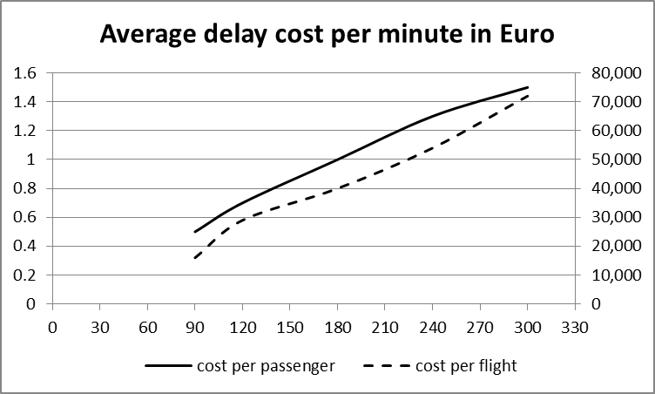
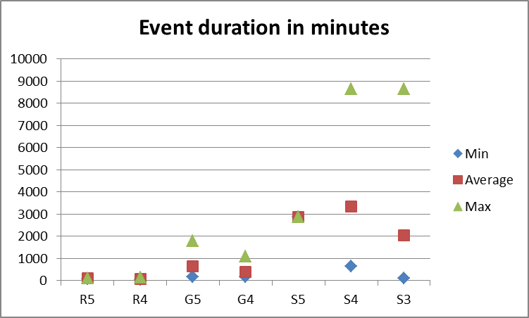
Economic Costs - Aviation
Cross-sectoral and international spillovers
Radiation and geomagnetic storms mainly affect cross polar routes (hence North America and Asia). (Cost of rerouting) X (Portion of flights rerouted in a given region).
Solar flares cause communication problems for cross Atlantic routes (assume day light exposure for full event duration). (Number of flights/passengers delayed) X (Average delay cost).

Slide 16
Prudence/limitations of estimates
Timing and location (rural vs. urban area) follow the footprints of actual storms, without looking for maximum exposure configurations.
Loss amplification along the storm paths is ignored: gradual weakening of power grid through repeated substorms is not captured.
International spillovers: long lasting impacts on global trade ignored; this captures in reduced form a bullish view on system resilience.
Potential impact of solar radiation on health (e.g., aviation) is currently ignored.
Clustering of other events (windstorms/flood), which might undermine the resilience of the existing infrastructure, is ignored.

Slide 17
Conclusions – Economic Impact
Project took a conservative approach.
In a reasonable worst case space weather event (1 in 100 year) the UK might reasonable expect to incur financial losses of up to €5bn. Across Europe and Scandinavia this figure could reach €82bn.
Financial impacts occur when sub-storms reach particular intensity thresholds regardless of whether they occur as part of a 1-in-30 or 1-in-100 year event.
Costs relating from the loss of power far outweigh the costs incurred by civil aviation.

Slide 18
Conclusions – Forecasting Benefit
A clear financial benefit is derived from space weather forecasting
Without L1 observations, the current costs estimates could increase by factors of
power sector - 100-200%
aviation sector - 49%
With additional L5 observations, the current cost estimates could be reduced by factors of
power sector - 50-76%
aviation sector - 28%

Slide 19
Further Work Required
A study into the impacts of GNSS loss - enable the financial implications to be calculated.
An extension of this study to rerun our model multiple times with different start times, to create an ensemble of results which reflected where on the globe the space weather event was focused.
The model could be reconfigured and rerun using a different range of scenarios.
Much of the economic impact on the UK power grid can arise from a single intense substorm - need to assess the likelihood of such isolated events.
An investigation into impact on the global economy in the months and years following a space weather event

